Slide 1

Selenium Workshop
Name of the presenter:
Date: Wednesday, July 16, 2014

Slide 2
Selenium - Course Coverage
What is Automation?
What is Selenium?
Modes of Selenium
Selenium Flavors
Overview of Selenium IDE
Test Creation Demo with help of Selenium IDE
Execution Mode-Test Runner Mode
Executing & debugging the scripts
Overview of Ruby
Programming with Ruby
Overview of Selenium RC
Object Recognition
Scripting and Execution using Selenium RC

Slide 3
What is Automation?
It is process of writing computer program to do testing.
Once tests have been automated, it can be executed unattended
Cost effective method
Long maintenance life
Virtually unlimited iterations of test case execution
Finding defects missed by manual testing
Customized reporting of application defects

Slide 4
What is Selenium?
A functional testing tool for web applications.
It runs tests via a real browser that is driven by a JavaScript engine which is called "the BrowserBot".
Works with any JavaScript-enabled browser
It is Open Source and Freeware.
Easy to Record Script and Play back of scripts
Allow Cross browser testing (Record in Firefox, Execute in IE)
No dedicated machine required for test execution( user can work in parallel) ( minimize browser.)
Selenium uses JavaScript and IFrames to embed the BrowserBot in your browser
The engine is tweaked to support wide range of browsers on Windows, Mac OS X and Linux

Slide 5
Modes of Selenium
Selenium Runs in two modes:
Test Runner Mode
The framework and the tests themselves are deployed as Web pages inside the Web server under test.
It deploys a browser bot that runs alongside your application.
At that point, the BrowserBot engine is downloaded in your browser and is ready to process tests written as HTML tables.
Consequently, it will work with any javascript-enabled browser.

Slide 6
Modes of Selenium (Contd..
2. Driven Mode
It provides a way to automatically drive a browser from an application written in Python, Ruby, Java or .NET.
The Selenium framework provides "drivers" for these languages, which translate from a given language into "Selenese" commands that get fed to the BrowserBot engine inside the browser.

Slide 7
Selenium Flavors
Selenium Core
Selenium IDE
Selenium Remote Control
Selenium Grid
Selenium WebDriver

Slide 8
Selenium Core
Utility for running tests in web browser
Selenium HTML language is called Selenese
Implemented in 100% Java
Works on a large selection of browsers and operating systems
One of the best features of Selenium Core is the ability of testing for browser compatibility.

Slide 9
Selenium IDE
Selenium IDE is a Firefox plug in, allows you to record, play back, edit, and debug tests in browser.
Selenium IDE is the only flavor of Selenium which allows you to record user actions on browser window.
It can also record user actions in most of the popular languages like Java, C#, Perl, Ruby etc. This eliminates the need of learning new vendor scripting language. However to run them in an automated fashion you need to use Selenium Remote Control.

Slide 10
Selenium IDE (Contd…)
Selenium default scripts are html (added JavaScript) and that is the script we are going to use it in selenium IDE
The reason for availability of other language is, user can get the scripts for Selenium Remote Control.
It also has a context menu (right-click) integrated with the Firefox browser, which allows the user to pick from a list of assertions and verifications for the selected location

Slide 11
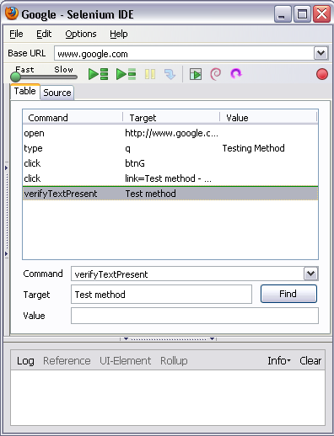
Steps for Installation of Selenium IDE:
Download Selenium IDE.
Copy Selenium IDE file to extensions folder of Mozilla Firefox.
To facilitate opening of .xpi file for selenium you can drag and drop the .xpi file on the mozilla browser to install it and get it in the add-ons of the browser.

Slide 12
Selenium IDE Concepts
There are 3 columns
Command
Target
Value

Slide 13
Selenium IDE Concepts
Command: A command that tells Selenium what to do. Selenium commands has
three flavors:
-> Actions
-> Accessors
-> Assertions
Target : Element Locators tells Selenium that which HTML element a command refers to
-> Element Locator
-> Patterns
Value: Specify the value which user wants

Slide 14
Actions
Represent something a user can do
Manipulate the state of application
Actions generally come in 2 forms: action and actionAndWait
action performs the action
actionAndWait assumes a server call and thus waits long for a response
open automatically wait

Slide 15
Assertions
Allows user to verify the state of the application
Three modes
Assert – Upon failure, test is aborted
Verify – Upon failure, the test continues running (logging the failure)
waitFor
Waits timeout time for a condition’s truthiness
Great for testing background Ajax behavior

Slide 16
Accessors
Examine the state of the application and store the results in variables, e.g. "storeTitle". They are also used to automatically generate Assertions
Following are few accessors of Selenium:
storeAlert ( variableName )
Retrieves the message of a JavaScript alert generated during the previous action, or fail if there were no alerts.
storeAllButtons ( variableName )
Returns the IDs of all buttons on the page. If a given button has no ID, it will appear as "" in this array.
storeAllFields ( variableName )
Returns the IDs of all input fields on the page. If a given field has no ID, it will appear as "" in this array.
storeAllWindowIds ( variableName )
Returns the IDs of all windows that the browser knows about.

Slide 17
Element Locators
Types of Element Locators
Locating by identifier
Locating by id
Locating by name
Locating by X-path
Locating by DOM

Slide 18
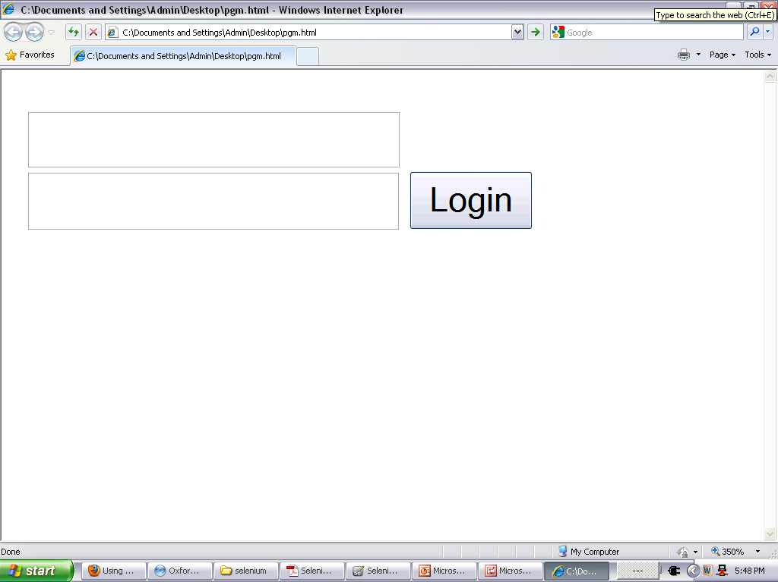
Locating by identifier
<html>
<body>
<form id= "loginForm" >
<input name= "username" type= "text" />
<input name= "password" type= "password" />
<input name= "continue" type= "submit" value= "Login" />
</form>
</body>
<html>
identifier=loginForm
identifier=password

Slide 19
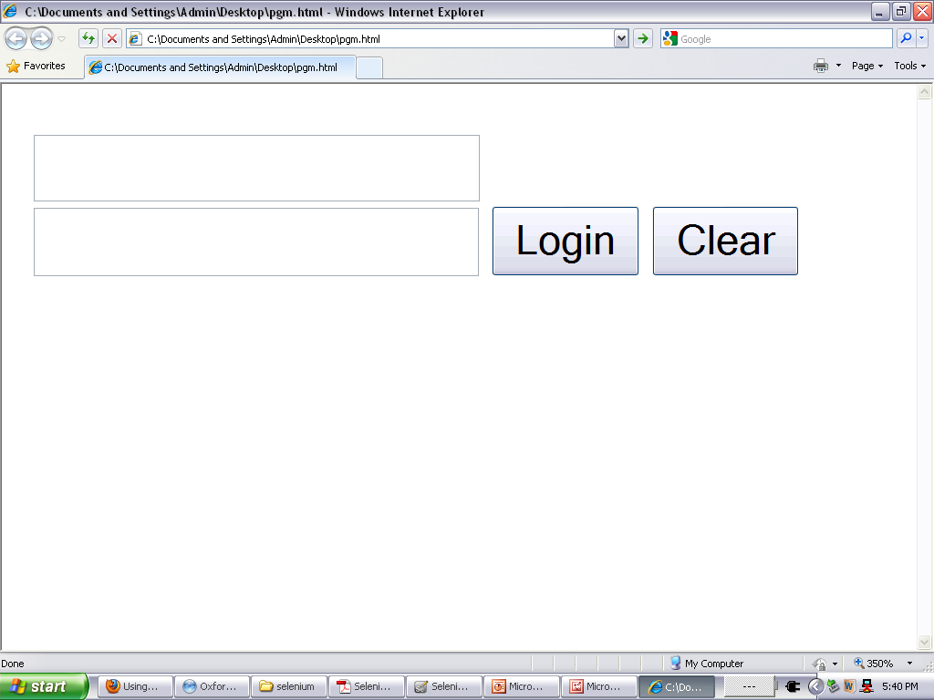
Locating by id
<html>
<body>
<form id= "loginForm" >
<input name= "username" type= "text" />
<input name= "password" type= "password" />
<input name= "continue" type= "submit" value= "Login" />
<input name= "continue" type= "button" value= "Clear" />
</form>
</body>
<html>
Id = loginForm

Slide 20
Locating by name
name=username
name=continue value=Clear
name=continue Clear
name=continue type=button
1 <html>
2 <body>
3 <form id= "loginForm" >
4 <input name= "username" type= "text" />
5 <input name= "password" type= "password" />
6 <input name= "continue" type= "submit" value= "Login" />
7 <input name= "continue" type= "button" value= "Clear" />
8 </form>
9 </body>
10 <html>

Slide 21
Locating by X-path
xpath=//form[@id=’loginForm’]
//input[@name=’username’]
Since only xpath locators start with “//”, it is not necessary to include the xpath= label when specifying an X-path locator.
<html>
<body>
<form id= "loginForm" >
<input name= "username" type= "text" />
<input name= "password" type= "password" />
<input name= "continue" type= "submit" value= "Login" />
<input name= "continue" type= "button" value= "Clear" />
</form>
</body>
<html>

Slide 22
Locating by DOM
The Document Object Model represents an HTML document and can be accessed using JavaScript.
This location strategy takes JavaScript that evaluates to an element on the page.
Since only dom locators start with “document”, it is not necessary to include the dom= label when
eg:
dom=document.getElementById(’loginForm’)
dom=document.forms[0]
document.forms[0].elements[0]
document.forms[0].elements[3]
<html>
<body>
<form id= "loginForm" >
<input name= "username" type= "text" />
<input name= "password" type= "password" />
<input name= "continue" type= "submit" value= "Login" />
<input name= "continue" type= "button" value= "Clear" />
</form>
</body>
<html>

Slide 23
Patterns
Patterns: Patterns allow you to describe, via the use of special characters, what text is expected rather than having to specify that text exactly.
glob:pattern
Match a string against a “glob” pattern.
“*” represents any sequence of character
“?” represents any single character
Glob patterns match against the entire string
regexp:regexp
Match a string using a regular-expression.
The full power of JavaScript regular-expression is available.
exact:string
Match a string using a exact pattern
The full power of JavaScript regular expressions is available.
If no pattern prefix is specified, Selenium assumes it’s a “glob” pattern

Slide 24
Patterns (Contd..)
Regular Expression:
Pattern | Match
. | Any single character
[ ] character class | any single character that appears inside the brackets
* quantifier | 0 or more of the preceding character(or group)
+ quantifier | 1 or more of the preceding character (or group)
? quantifier | 0 or 1 of the preceding character (or group)
{1,5} quantifier | 1 through 5 of the preceding character (or Group)

Slide 25
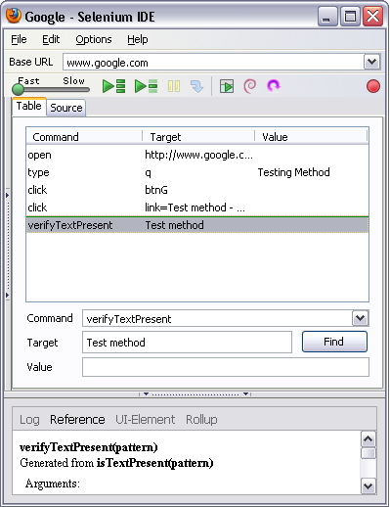
Components of Selenium IDE
Record Test Actions
Execution Commands
Try the test in the Web Based TestRunner
Reference of currently selected command
Specify commands, including Asserts

Slide 26
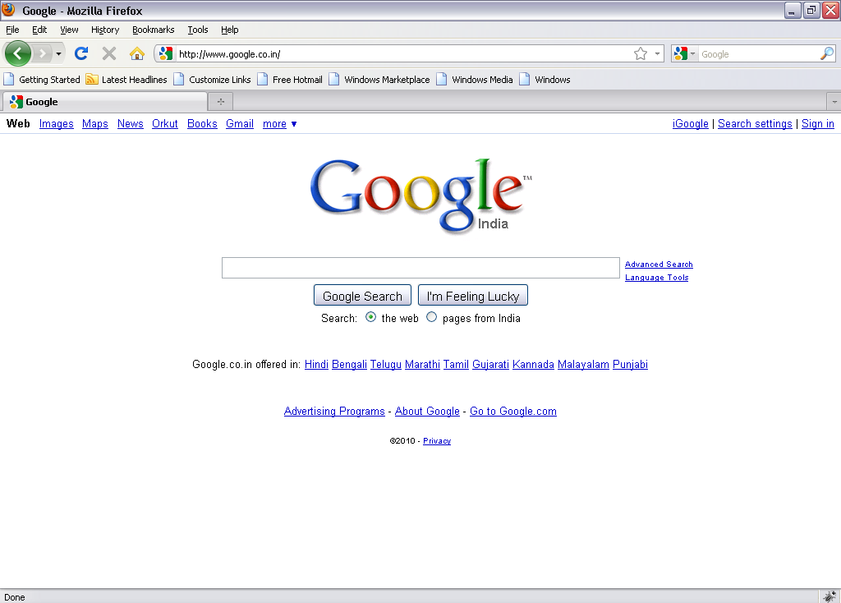
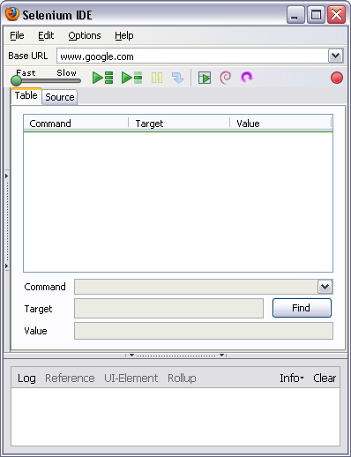
Test Creation Demo with help of Selenium IDE
Go to the Web Page for which you want to carry out the test
Hit the record button on IDE

Slide 27
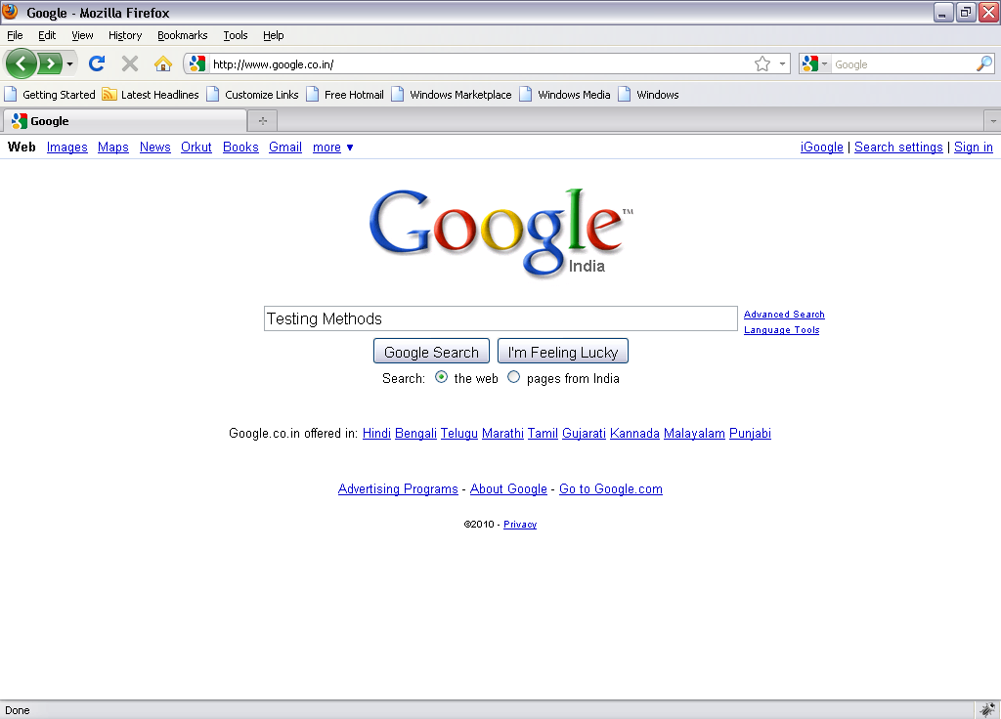
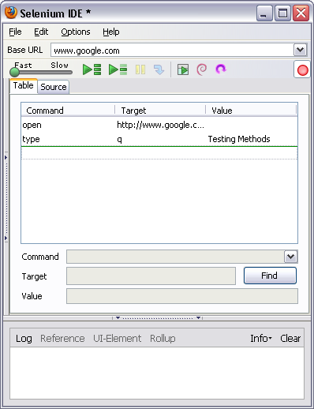
Test Creation Demo with help of Selenium IDE (Contd..
Enter the text on Web Page and submit
IDE should be updated, stop the recorder and add the assertions

Slide 28
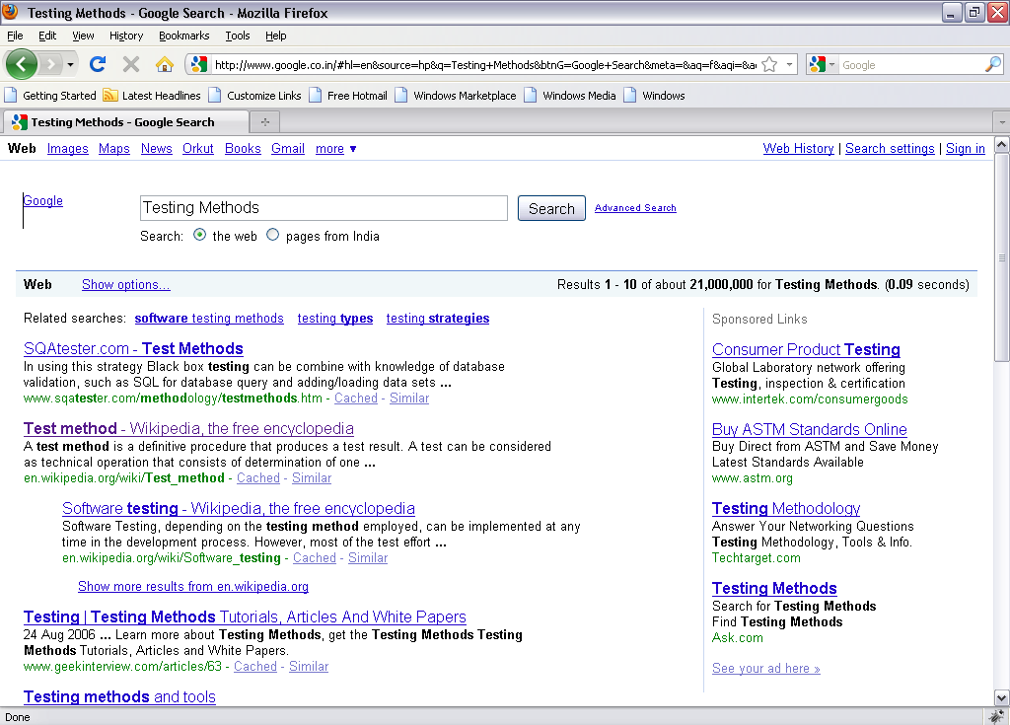
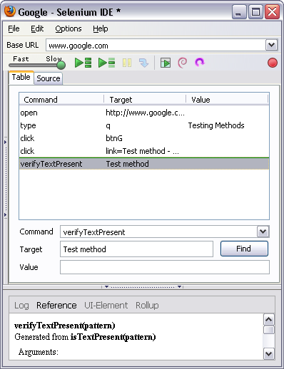
Test Creation Demo with help of Selenium IDE (Contd..
Play Button
Hit the play button to play the recorded scripts

Slide 29
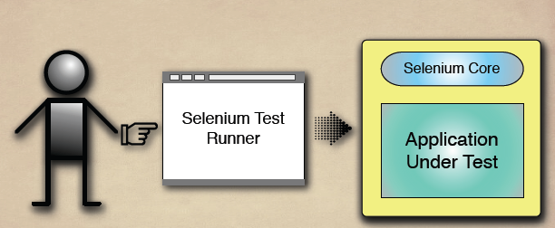
Test Runner mode of IDE

Slide 30
Test Runner and It’s Control

Slide 31
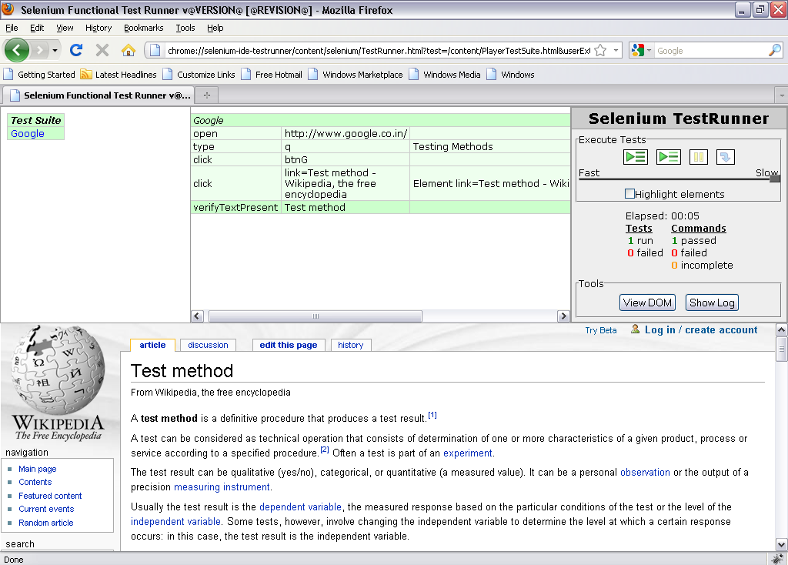
How to execute the Test Case in Test Runner mode.
Hit the play button to play the test script

Slide 32
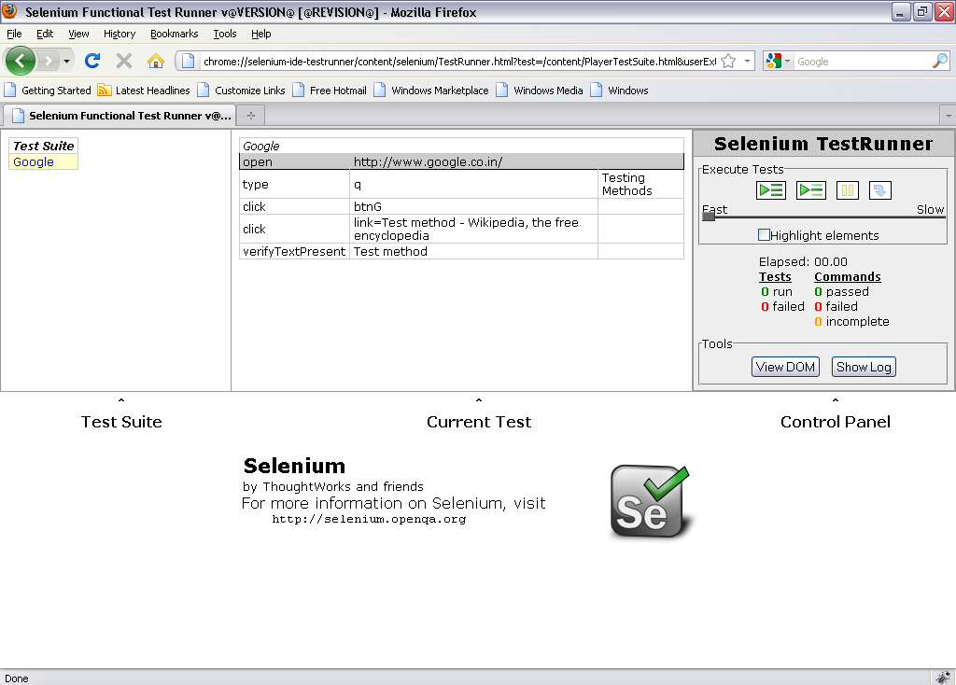
Execution & Debugging the scripts
Set Debug Point

Slide 33
Execution & Debugging the scripts (Contd..
Click on Run the Selected Test

Slide 34

Execution & Debugging the scripts (Contd..
Click on Steps

Slide 35
Execution & Debugging the scripts (Contd..

Slide 36
Overview of Ruby
Ruby is "an interpreted scripting language for quick and easy object-oriented programming";
interpreted scripting language:
ability to make operating system calls directly
powerful string operations and regular expressions
immediate feedback during development
quick and easy:
variable declarations are unnecessary
variables are not typed
syntax is simple and consistent
memory management is automatic
object oriented programming:
everything is an object
classes, inheritance, methods, etc.
singleton methods
mixing by module
iterators and closures
Ruby file has .rb extension

Slide 37
Programming with Ruby
Functions/Methods
Output:
def sayGoodMorning(name)
result = "GoodMorning, " + name
return result
end
# Time to say good morning
puts sayGoodMorning("John")
puts sayGoodMorning("Mary")
GoodMorning, John
GoodMorning, Mary

Slide 38
Programming with Ruby (Contd..
Arrays
Empty Array
a = [ 1, 'cat', 3.14 ] # array with three elements
# access the first element
a[0] » 1
# set the third element
a[2] = nil
# dump out the array
a » [1, "cat", nil]
empty1 = []
empty2 = Array.new

Slide 39
Programming with Ruby (Contd..
If Statement
Output: poor
x=2
if x==10
puts("Good")
elsif x>10
puts("Very Good")
else
puts("Poor")
End

Slide 40
Programming with Ruby (Contd..
While Statement
Output: 3
x=1
while x<2
x=x+1*2
end
puts x

Slide 41
Programming with Ruby (Contd..
Regular Expression
Output:
strtext="Hello, How are you?,Hello Good morning"
if strtext=~ /Hello|Hi/
puts "Text Matched,#{strtext}"
else
puts "No match found"
end
#Replace character matched with Regular Expression
puts strtext.sub(/Hello/,'Hi') #replace first 'Hello' with 'Hi'
puts strtext.gsub(/Hello/,'Hi') #replace every 'Hello' with 'Hi'
Text Matched,Hello, How are you?,Hello Good morning
Hi, How are you?,Hello Good morning
Hi, How are you?,Hi Good morning

Slide 42
Programming with Ruby (Contd..
Class, object & Attributes
Output
class Newsong
def initialize(name,artist,duration)
@name=name
@artist=artist
@duration=duration
end
def name
@name
end
def artist
@artist
end
def duration
@duration
end
end
objsong=Newsong.new("Dilse","Rehman",260)
puts objsong.name
puts objsong.artist
puts objsong.duration
Dilse
Rehman
260

Slide 43
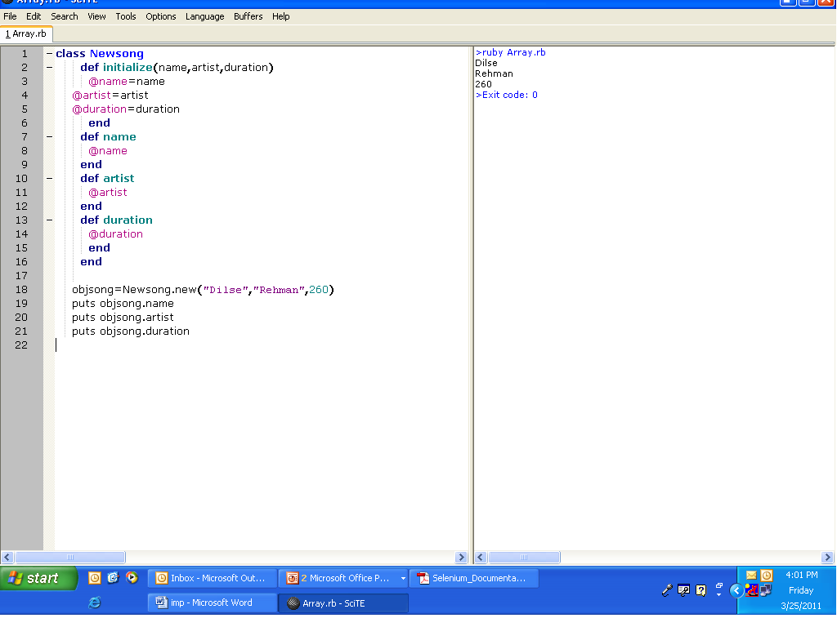
Array output

Slide 44
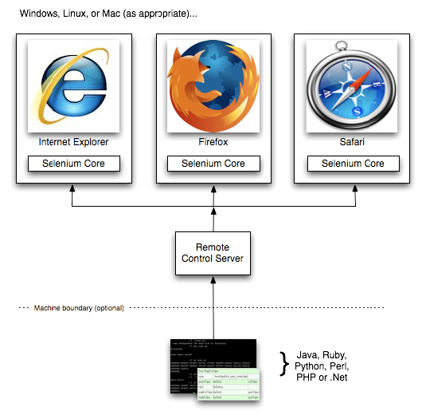
Overview of Selenium RC
Consists of two parts:
1. Selenium Server
2. Selenium Client Drivers for Java, .Net, Perl, Ruby and Python
Allows you to write automated tests in any language against any HTTP website using any JavaScript-enabled browser.

Slide 45
Selenium RC (Contd..
SELENIUM SERVER
Can automatically start/stop/control any browser.
Works by using Selenium Core.
You can communicate with the server using HTTP GET/POST request.
Communicates directly with the browser using XmlHttpRequest.
Selenium Server acts as a client-configured HTTP proxy to stand in between browser and web application.

Slide 46
Selenium RC (Contd..
SELENIUM CLIENT-DRIVER
To write automated scripts in any language.
Interaction with the Selenium RC Server.
Since it is open source you can create your own client driver.
Can create a selenium object in your automation script which can interact with the browser.
DefaultSelenium object has methods that handle Selenium commands.
Use Client-Driver with Testing Framework like JUnit.

Slide 47
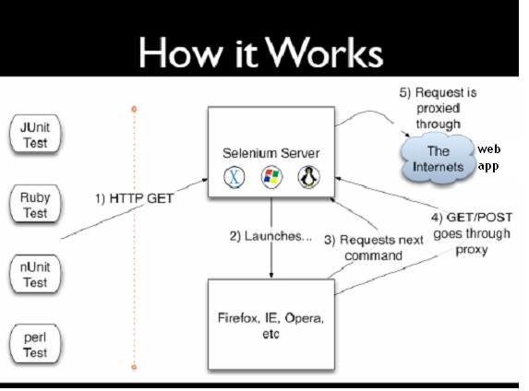
How Selenium RC works

Slide 48
How Selenium RC works (Contd..
Selenium gets an HTTP request from external framework like JUnit, nUnit, PerlUnit,etc
Selenium Server creates a session id and launches browser with that id
Browser sends the request/commands to the server with the help of the session id
Request is proxied through the Internet and your Application Under Test is launched
Selenium Remote Control can read the data from the external files.

Slide 49
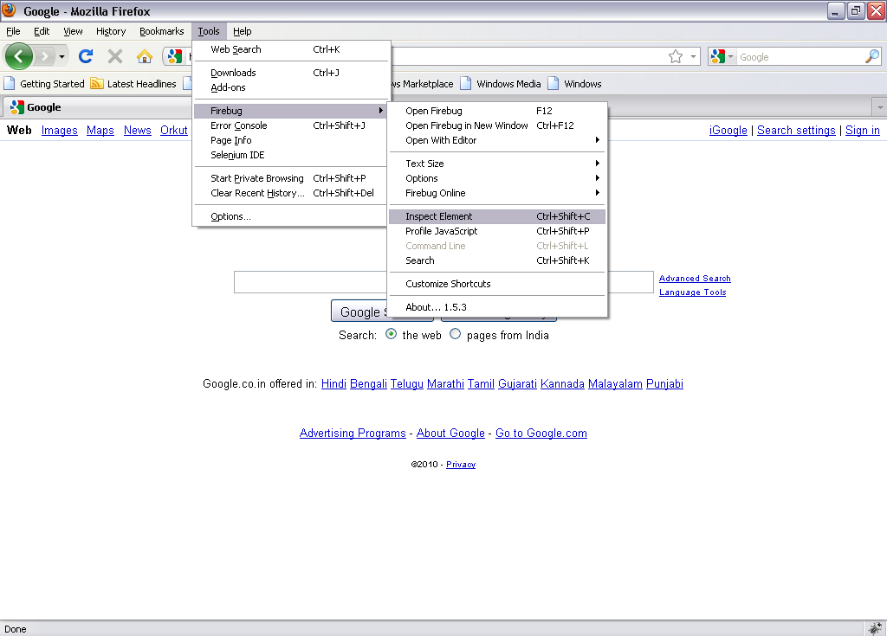
Object Recognition
It is using Fire bug to recognize the objects.

Slide 50
Object Recognition (Contd..
Steps to Highlight the objects using Firebug
Open Mozilla Firefox.
Go to Tools → Click on Firebug → Click on Inspect Element
Move mouse curser over the controls
You can see highlighted control in Firebug window.

Slide 51
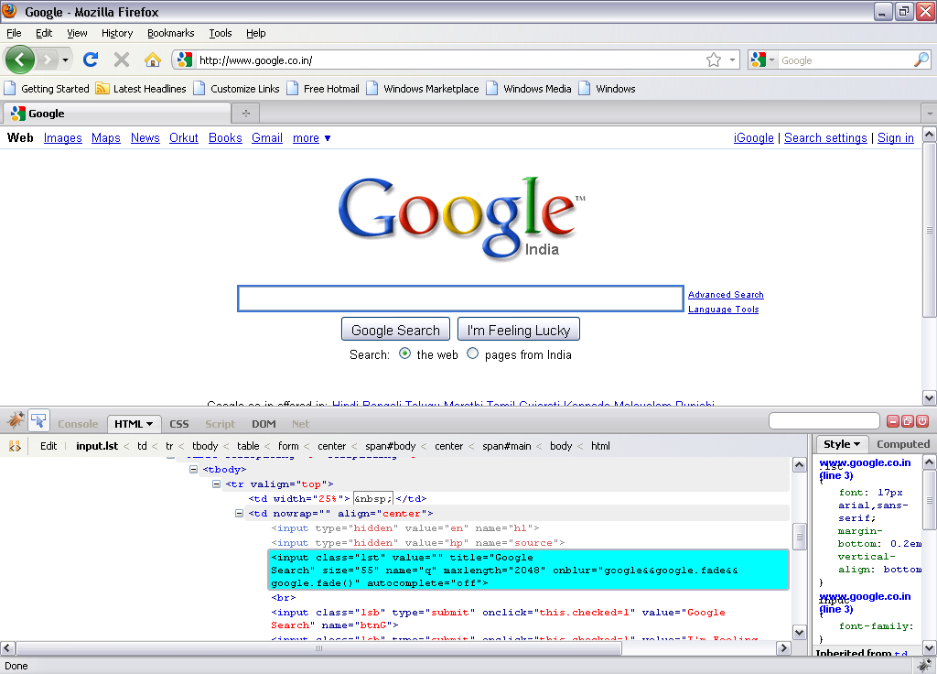
Object Recognition (Contd..

Slide 52
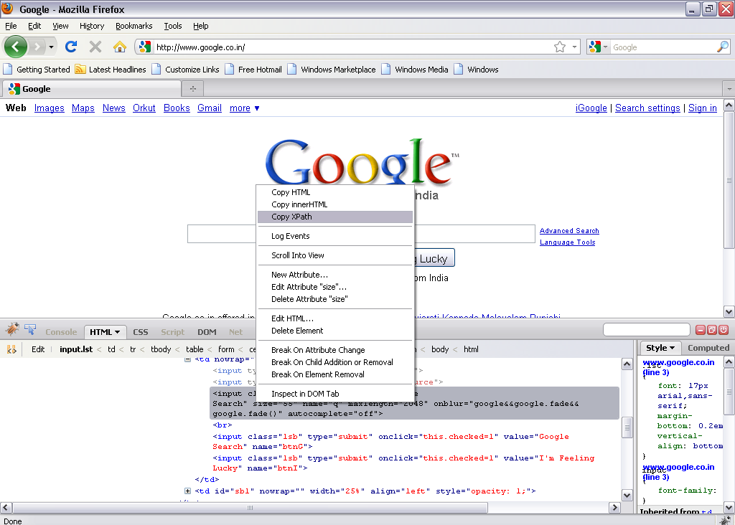
Object Recognition (Contd..

Slide 53
Scripting and Execution using Selenium RC
Scripting
Import Required files
Create Class
Create three methods/functions
Setup()
Used to initialize the selenium object.
Teardown()
Used to cleanup the selenium object after each test
Test_filename
Used to write business logic.
Execution
To execute ruby script, press F5

Slide 54
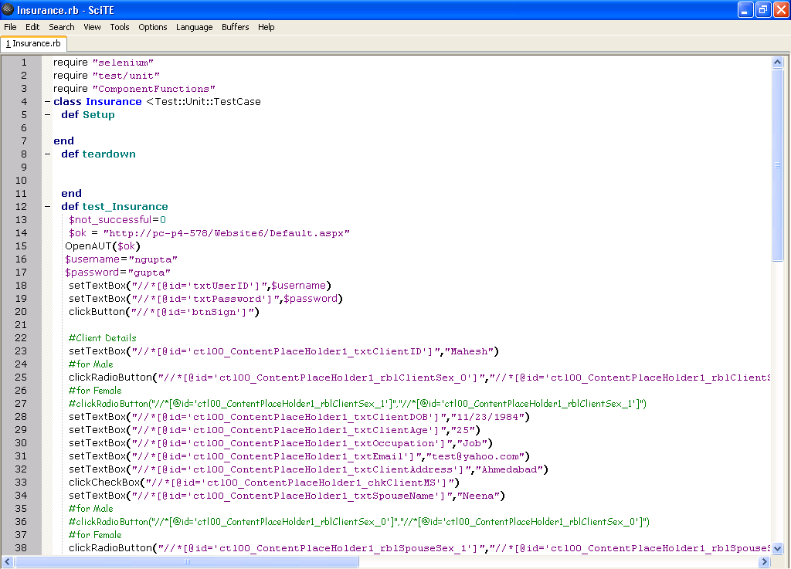
Scripting and Execution using Selenium RC (Contd..
Import Required Files
Import Required Files
Create Class
Setup Method
Teardown Method
Teardown Method
Test_Insurance Method

Slide 55
Thank You

